Slide 1
SHOOT DEVELOPMENT
The shoot development commences after germination is completed. The growth of the shoot is the result of the meristematic cells at the apex known as shoot apical meristem.
THE SHOOT APICAL MERISTEM
The apex of the shoot tip consists of a mass of closely packed cells with dense cytoplasm, conspicuous nuclei, small vacuoles and thin cell wall.
The shoot apical meristem cells of the embryo first start dividing and form a group of cells which are referred to as initials.
These initials divide giving rise to the layers of cells within the shoot apex.
The shoot apex can be divided into two regions – a surface layer (tunica) and an underlying mass of cells (corpus).

Slide 2
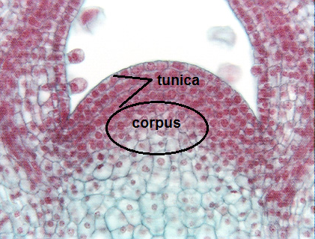
SCHMIDT’S TUNICA – CORPUS THEORY
According to SCHMIDT’S TUNICA – CORPUS THEORY, the tunica is the outer one or two layer of the cells at the shoot apex produced by the initials that divide anticlinally (plane of division at right angles to the surface of the apex).
The tunica increases only in area. The mass of cells beneath the tunica layer are referred to collectively as the corpus.
The corpus is several layers deep divide in all planes and increase in bulk.

Slide 3
The tunica and corpus together form a structure known as PROMERISTEM – the most distal part of the apical meristem.
The promeristem cells continue dividing giving rise to three primary meristem – the protoderm, the procambium and the ground meristem.
The promeristem together with the primary meristem forms the shoot apical meristem of the growing seedling.

Slide 4
There is no exchange of cells between the tunica and corpus, and there is no relation between zonation in the promeristem and the subsequent formation of specific tissues.
For instance, the outermost layer of the tunica give rise to the epidermis whiles the division of corpus cells produce tissues of cortex, vascular bundles and pith.

Slide 5
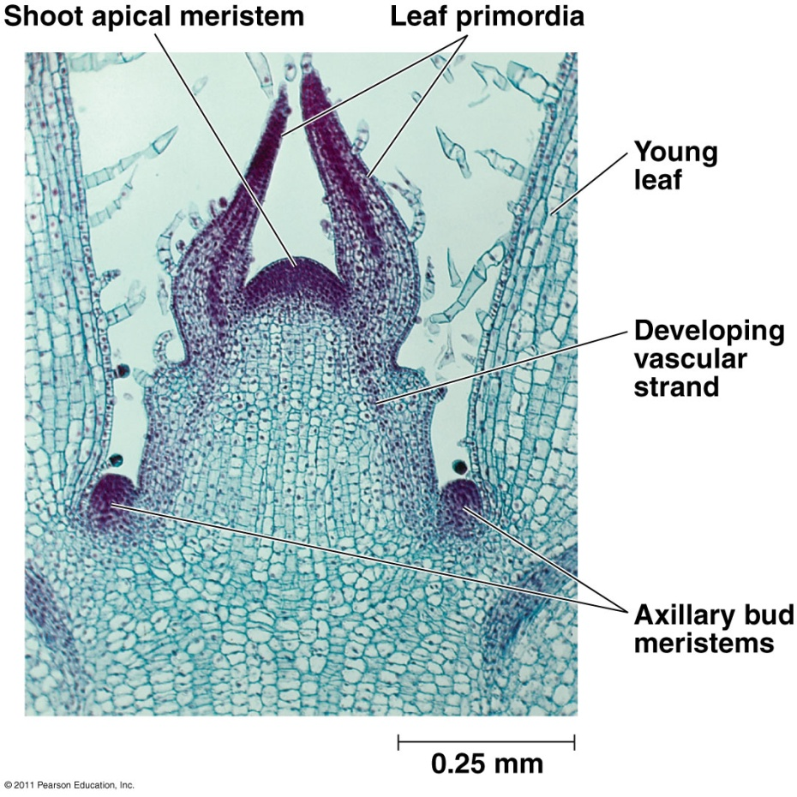
Below the promeristem the some outer cells give rise to LEAF PRIMORDIA. They arise around the circumference of the apical meristem.
Dividing cells initially from a lateral protrusion known as LEAF BUTTRESS which soon grows and elongates forming more prominent leaf primordium.

Slide 6
The pattern and number of leaf primordia developing around the circumference varies according to the species.
As the shoot extends upwards, more leaf primordia are formed above the initially formed primordia.
The newly formed primordia are close to the promeristem and older primordia are pushed downwards.
The leaf primordia quickly grow up taller than the apex itself.
Those further back arch over the younger ones protecting them from desiccation and damage.

Slide 7
The most important function of shoots is to produce leaves which are the main regions of synthesis of most plants, and modified floral leaves bear the reproductive organs.
Further development of the leaf primordia leads to formation of the leaves.
The point of attachment of the leaf is called the node and the segment of stem between two adjacent nodes is called internode.

Slide 8
Similarly, AXILLARY BUDS arise by division of cells in the axil of leaves slightly above the insertion of the subtending leaf.
An apical meristem is soon organized in the protrusions with the same arrangement as in the apical meristem of the parent shoot.
The development of the axillary bud is said to be exogenous because it arises from superficial tissue.

Slide 10
ROLE OF AUXIN – INDOLE ACETIC ACID
Auxin is produced in apices, which are usually meristematic. The apex thus has two function: production of cells and production of auxin.
Auxin affects the elasticity of cell wall and plays a major role in the enlargement of the cell during growth and development.
Auxin binds to the cell membrane resulting in several events that aid cell enlargement.
One early effect is the alteration of permeability of the cell membrane allowing H+ ions to leak into the cell wall.
Since an increase in H+ ion concentration causes an increase in acidity, the acidity of the cell wall is increased.
Within the cell wall is the cell wall digesting enzymes, called GLYCOSIDASES, which are only active in an acidic environment. As H+ ions accumulate in the cell wall, these glycosidases become active and begin to digest the hemicelluloses and pectin ‘cement’ that had been keeping the cell wall from stretching and the wall becomes stretchable.

Slide 11
The change in the permeability of the cell membrane also leads to increased uptake of water and ions by the cell.
In addition to the above effects, auxin stimulates respiration thereby increasing the production of ATP to support protein and cell wall synthesis.
Cell enlargement results from all these separate effects on the cell because:
The existing cell wall becomes stretchable as the result of the partial digestion of the cement holding the cellulose fibres in place
The protoplast exerts pressure (turgor pressure) on the cell wall which causes the cell wall to stretch, and
The existing cell wall does not become thin in the same manner as an expanding balloon, because the cell produces new cell wall material at the same time which is deposited in the expanding wall.

Slide 12
FORMATION OF VASCULAR TISSUE
Tunica and corpus cells divide and give rise to the primary meristems. The cells of primary meristem initially are mass of closely packed cells with dense cytoplasm, conspicuous nuclei, small vacuoles and thin cell wall. Later few cells from primary meristem develop vacuolation and these cells form pith and the cortex
Between them the remains cells which retain their dense cytoplasm for a longer time. These are the procambium cells which later form the vascular tissue. They divide longitudinally and results in the cells becoming narrower than other cells at the same level. Their pattern of distribution indicates the future position of the vascular tissues.
The phloem appears in the outer part of the pro-cambium and the xylem in the inner part. Because of this order of the differentiation, the xylem is said to be ENDARCH. It is thought that these differentiations may be influenced by the substances from the apex and the young leaf primordia.

Slide 13
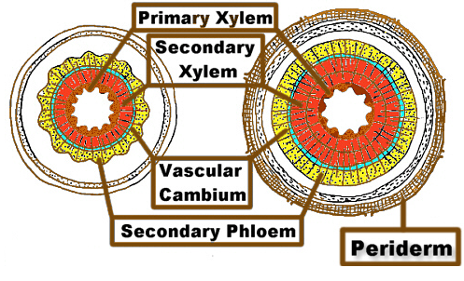
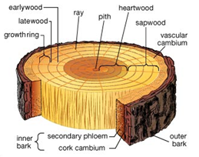
In most dicots the primary growth is followed by secondary growth which results in the formation of more xylem tissue that gives strength to the stem. This also increases the girth (width) of the plant.

Slide 14
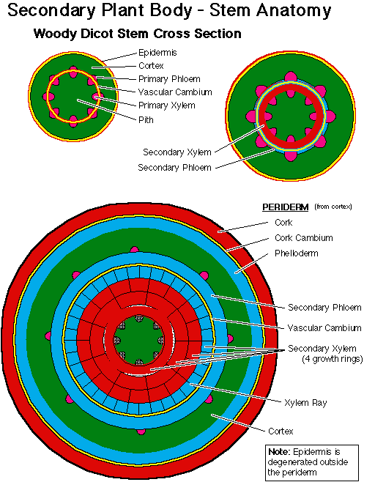

Slide 15
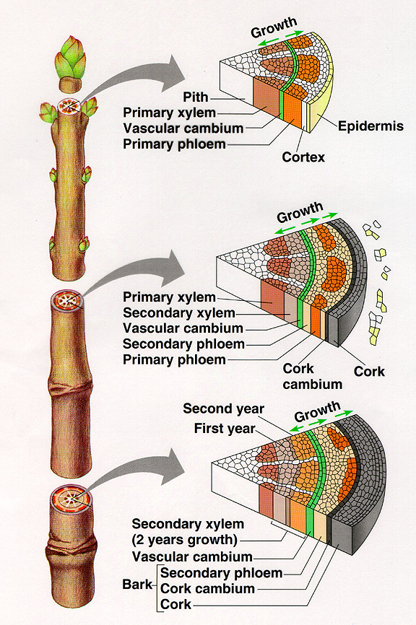
SECONDARY GROWTH
Notes:
15

Slide 16
Functions of the Stem
The stem gives support to the branches and leaves.
It helps in the upward conduction of water and mineral salts and downward conduction of prepared food material.
When the plant matures, the stem and the branches take part in the formation of reproductive structures (flowers).
The underground modified stems serve to store food materials.
The underground stems and a few aerial stems take part in vegetative reproduction.
In most of the plants, the stem is aerial and in a few plants the stem is underground. The aerial stem may be erect or weak.

Slide 17
Functions of Shoot
The shoot consists of stem, branches and leaves. The shoot has main functions of conduction and support but may undergo certain modifications to perform special functions.
Normal Functions
Special Functions
Supports branches and holds leaves to access maximum sunlight
Storage of food
Climbing
Protection
Vegetative reproduction
Photosynthesis
Upward conduction of water and mineral salts and downward conduction of prepared food material
Take part in formation of reproductive structures

Slide 18
Stem Modifications
Generally, the stems are aerial and grow above the soil surface. Sometimes, the stem becomes variously modified to perform special functions like vegetative propagation and food storage. The modified stems may be grouped under three heads
underground
sub-aerial
aerial.

Slide 19
For food storage
The underground stems, by being situated below the surface of the soil, protect themselves against unfavorable conditions of weather and the attack of animals, and serve as store houses for reserve food, and in vegetative propagation.
Their stem nature can be distinguished by the presence of nodes and internodes, scale leaves at the nodes, axillary buds in axils of scale leaves and a terminal bud.
The underground stems are of four types namely
rhizome
tuber
bulb
corm

Slide 20
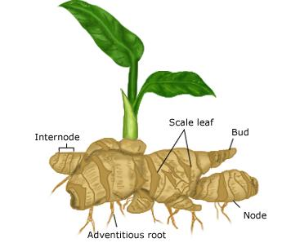
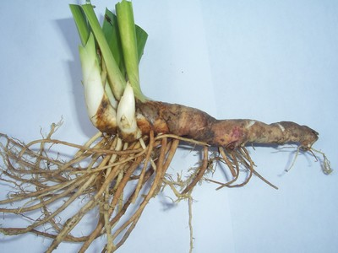
Rhizome
A rhizome is a thick horizontally growing stem which usually stores food material. It has nodes and internodes, scale leaves, axillary buds, adventitous roots and a terminal bud.
Some of the axillary buds develop into branches which grow upwards into the air and then produce normal green foliage leaves.
Roots develop from the lower surface of the rhizome. Eg. Ginger.

Slide 21
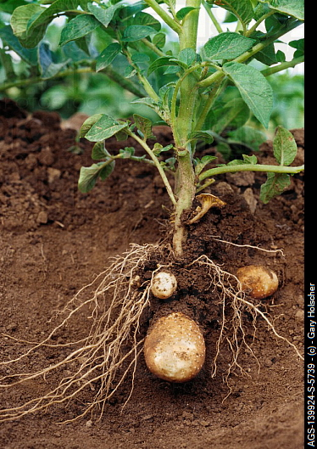
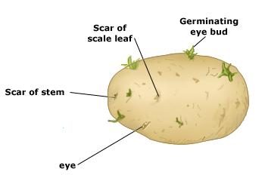
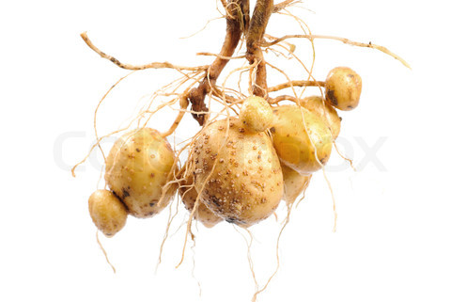
Tuber
Tuber is a swollen end of an underground branch which arises from the axil of a lower leaf of aerial shoot.
These underground branches grow horizontally in the soil.
On the surface of each tuber many leaf scars are seen. These leaf scars are the impressions of fallen scale leaves.
Each such leaf scar encloses an axillary bud.
A leaf scar with an axillary bud is called an eye. These eyes of potato are capable of producing new plants by vegetative propagation. E.g., Potato.

Slide 22
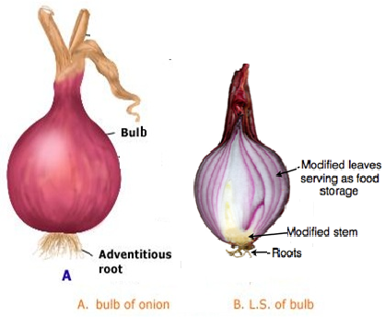
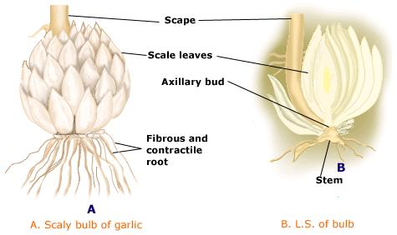
Bulb
Here, the stem is reduced and represented by a short disc. The lower surface of the stem produces many adventitious roots. E.g., Onion, Garlic.
In bulbs of onion, garlic, etc. the inner leaves are fleshy while the outer ones are dry.

Slide 23
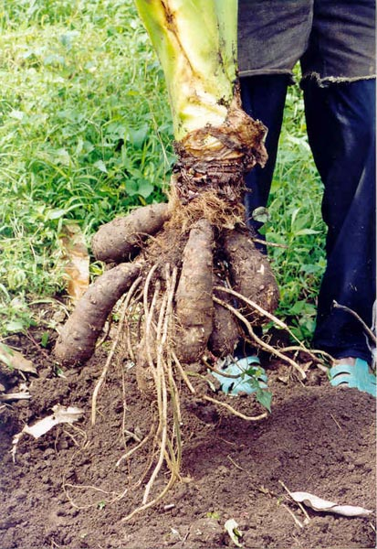
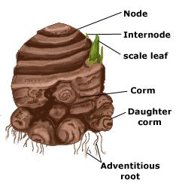
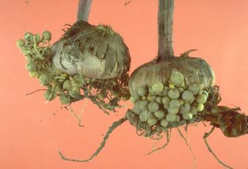
Corm
A corm is a greatly swollen underground basal portion of an erect stem due to the storage of reserve food material.
It bears scale leaves and axillary buds.
At the end of the growing season, the aerial parts die.
With the return of favorable conditions usually one axillary bud (rarely more than one) near the apex develops into a new shoot utilizing the food reserve material in the old corm.
The new plant produces a new corm at its base. The earlier corm shrivels off. E.g. Gladiolus sp., Xanthosoma sp (cocoyam).
Gladiolus corms with cormels

Slide 24
For Vegetative Propagation
In some plants, the stems are modified for the purpose of vegetative reproduction.
They are of the following types :
Runner
Offset
Stolon

Slide 25
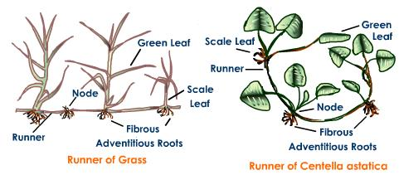
Runner
The runner arises from the base of the stem as a lateral branch and runs along the surface of the soil.
It develops distinct nodes and internodes. At each node, the runner produces roots below and leaves above.
In this way many runners are often produced by the mother plant and they spread out on the ground on all sides.
If any accidental injury results in the separation of a runner, the severed parts are capable of leading an independent existence. E.g., Oxalis sp., Centella astatica.

Slide 26
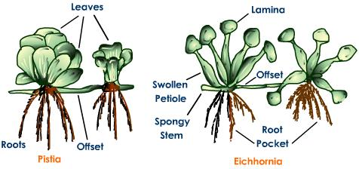
Offset
An offset is a short thick runner like branch which produces a new plant at its tip.
If any accidental injury results in the separation of these units, each is capable of leading an independent existence. E.g., Pistia sp., Eichhornia sp.

Slide 27
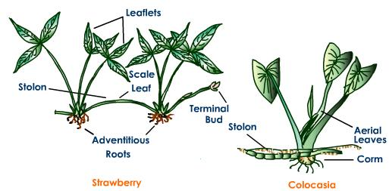
Stolon
A runner or any basal branch which produces roots is called a stolon.
stolons are lateral branches which originates from the underground stem.
The stolons grow horizontally outwards for a varying distance in the soil.
Ultimately their end (terminal bud) emerges out of the ground and develops into a new plant. E.g. Strawberry, Colocasia sp.

Slide 28
For Climbing and Protection
In some plants the aerial stem is modified to perform a variety of special functions like climbing and protection from herbivores:
Stem Tendril (climbing)
Stem Thorn (protection)

Slide 29
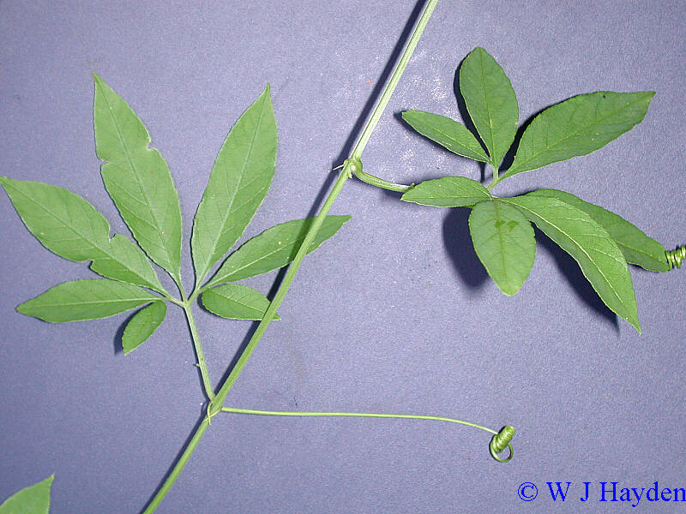
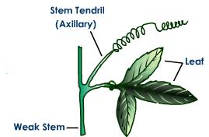
Stem Tendril
Tendrils develop as modifications of the stem in certain plants. Tendril is a slender, coiled branch.
The main function of the tendrils is to aid the plant in climbing a support to avail the plant maximum sunlight. The axillary bud becomes modified into a tendril e.g. Passiflora sp.

Slide 30
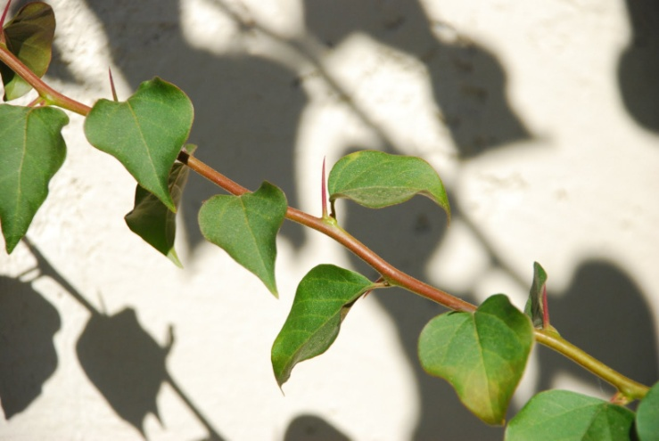
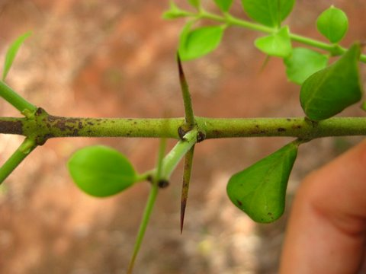
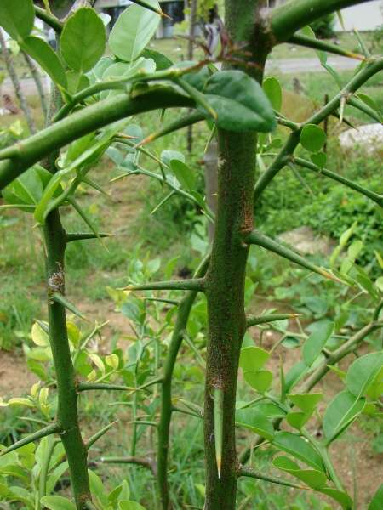
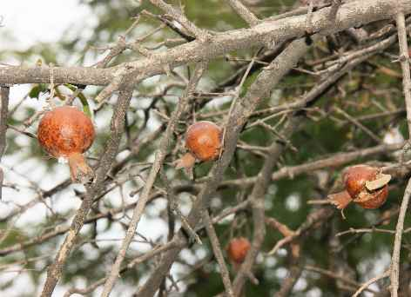
Stem Thorn
The thorn is a hard, straight, and pointed structure.
In the axillary bud is modified into a thorn.
In Carissa the terminal bud is modified into a pair of thorns.
The thorn sometimes bears leaves, flowers and fruits as seen in Pomegranate.
The thorns not only check the rate of transpiration but also protect the plants from herbivore grazing. Eg. Carissa, Citrus
Carissa
Bougainvillea
Citrus
Pomogranate

